Slide 1


BRIGHTBOARD Pitch Deck
Your students in our hearts.
Notes:
Introduction – Paz Slides 1-5
Application – Rajat 6-15
Competition and features, Market analysis – Olga 16-21
Revenue and prediction – Flavia till the end
1. How many of you used Blackboard to see at what time today's class is?
2. How many clicks does it take?
3. Do you think it can be better?
Welcome, we are brightboard, and we are here to talk about a product that is going to make your learning experience in this MBA "Brighter"

Slide 2
THE NEED
2.
4.
1.
3.
Knowledge evaluation
Management tools
(Calendars, teams, mailing)
Students and Teachers’ collaboration
Data & Reports
(Quizzes, tests, exams)
Notes:
The actual journey of a student and a teacher using Learning management systems includes the following needs
1. Uploading documents, sending messages, contributing in forums, looking at your calendars
2. Upload grades in the different tasks assigned, so your students can see their progress
3. Upload quizzes and exams which are resolved in the platform and are automatically saved in each student profile. A friendly way to create this templates
4. The use of a calendar that can be edited, easily send emails, create a section for your team with a detail of the tasks, deadlines, etc.
LMS - product that works towards these needs

Slide 3
NEEDS ACCORDING TO PARTICIPANTS
“I NEED TO EFFECIVELY MANAGE MY STUDIES AND DEADLINES”
STUDENT
“I NEED TO ORGANISE TEACHING AND EVALUATION PROCESS”
TEACHER
“WE NEED AN EFFECTIVE COLLABORATION TOOL TO DELIVER THE COURSE & MANAGED PROCESS”
UNIVERSITY
MGMT
Notes:
After some research we discovered which were the problems stakeholders were facing when using Blackboard
- Teacher: the platform should help them to make their job more easy and don't waist time on this things and use that time on the students
- Student: want to get good grades so doesn't want to miss any deadline or task to be done
- University mgmt: want to give the best platform for both students and teachers so they can have the best learning and teaching experience

Slide 4
THE PROBLEMS
COMPLEXITY
INTEGRATION
CUSTOMIZATION
1.
2.
3.
The current LMS have a steep learning curve on top of incoherent features
The other tools used simultaneously during study process are not integrated all across.
The current look and feel is not customizable to suit individual needs
and isn’t available across all platforms
Notes:
The problems we found were the following
1. Complexity: number of clicks one needs to go to the calendar, see what the classes are for the next day, then come back to the course, go to the syllabus and see what session it upcoming. Syllabus is hosted in a different system and calendar is not integrated with the booking system etc.
2. Integration: calendar, teams, email
3. Customization: not mobile friendly, can't edit the calendar and just stay with what you need, or add anything extra, you can't edit the colors

Slide 5
4. Time Management
Students lose a lot of time trying to navigate the system and search for the information; it is difficult to work with deadlines; a student cannot synchronise assignments and deadlines with his calendar effectively.
Notes:
The most important problem we identified was Time Management

Slide 6
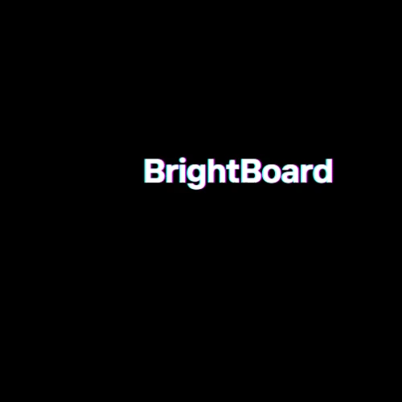
The solution
Notes:
Rajat

Slide 7
It is MOBILE FIRST! (as 72% of the people wanted from the survey)
And the best thing about The BrightBoard…
Notes:
Rajat
As was required by 72% of the people from the survey

Slide 8
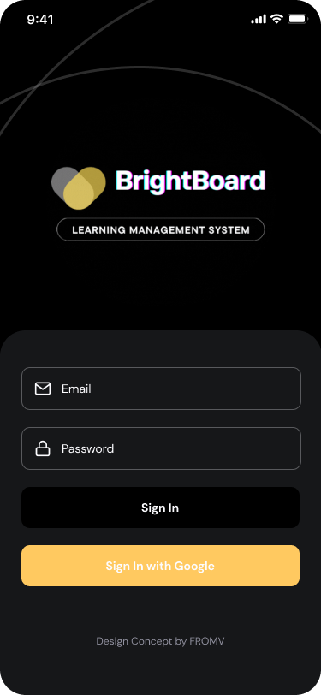
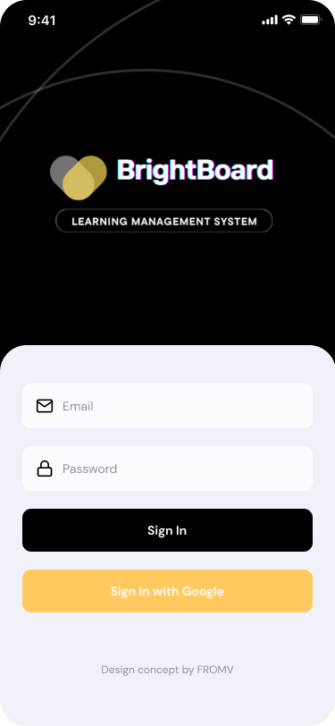
For the students,
Only team member that
Stays with you throughout the
11 MONTHS HERE ☺
Notes:
Rajat

Slide 9
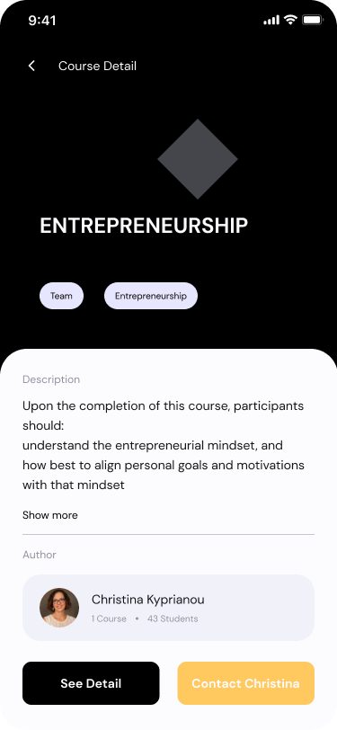
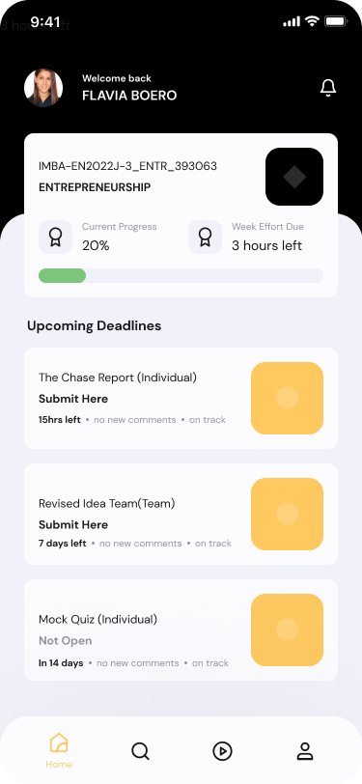
Many more great features are at your disposal all the time!
Listening to the
92%
People who feel current systems can be better.
Giving them
50%
Faster access to things they need.
Your students, in our hearts.
Notes:
Rajat

Slide 10
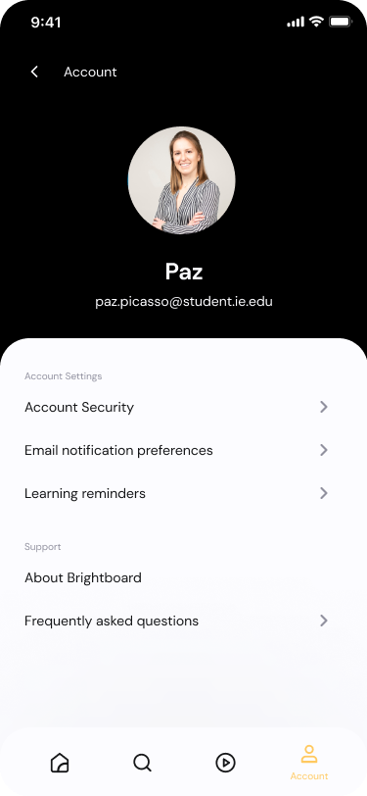
Power of Customisation IN USER’S HANDS
Set email reminders for courses, tasks, groups, assignments
Secure your accounts with Easy fingerprint login
Students and Professors can set automated
app notifications
Notes:
Add also face recognition for seccuring account

Slide 11
So much customisation that
We went with Dark Theme from the get go!
Our users, in our hearts.
Notes:
I don’t understand " the get go!"

Slide 12
Ease of complexity
IN OUR MINDS
All information about courses(deadlines, syllabus, calendar, announcements, email)
IN ONE TAP
Live courses
ALWAYS ON TOP
Never miss a notification or message for courses, tasks, groups, assignments

Slide 13
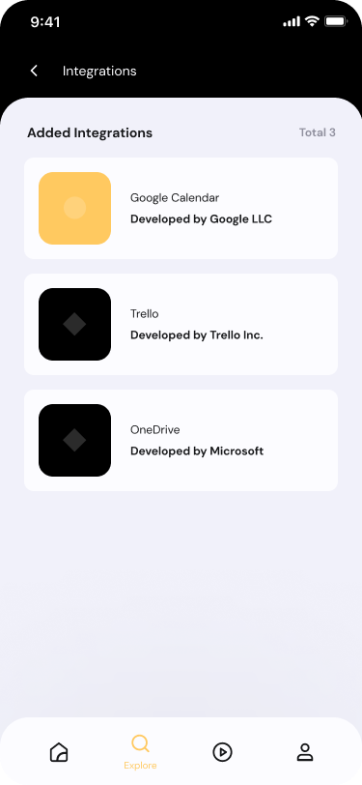




Power of Integration
TO TOP IT
Extend the ecosystem with
the tools you love.
As demanded by 68% of users

Slide 14
And a smart AI
TO MANAGE OUR TIME
Deadlines and effort
Calculated using ML based AI
Nudges and indicators to constantly manage your time
(and priorities)

Slide 15
Competition Overview

Slide 16



COMPETITIVE LANDSCAPE
Features
Basic
Effective time management
Intuitively simple user-friendly system
Integration with other studies tools
Customization

Slide 17
VALUE PROPOSITION
Key Differentiator: Effective time management
Deadline management
Calendar synchronization
Dashboard for reading
Chat Bot
Group To-Do list
Group assignment intelligence
PHASE 1
PHASE 2

Slide 18
PHASES & FEATURES
 | PHASE 1 | PHASE 2 | PHASE 3
The focus of the phase | Increase students' individual efficiency and improve time management | Establish collaboration and integration enabling an effective teamwork | Add intelligence to the system
Features | 1. Course organisation 2.Deadline management 3.Calendar synchronisation 4.Dashboard for readings and assignments (the system will calculate and show estimated time for class readings and individual assignments) 5.Unified mailing 6. Chat Bot | 1.Documents sharing 2.Team meetings 3.Group to-do list 4.Group assignments intelligence (evaluates estimated time to do the group assignment) | Set of integrated analytical tools for students, teachers, and university management to increase efficiency of study process
 | PHASE 1 | PHASE 2 | PHASE 3
The focus of the phase | Increase students' individual efficiency and improve time management | Establish collaboration and integration enabling an effective teamwork | Add intelligence to the system
Features | 1. Course organisation 2.Deadline management 3.Calendar synchronisation 4.Dashboard for readings and assignments (the system will calculate and show estimated time for class readings and individual assignments) 5.Unified mailing 6. Chat Bot | 1.Documents sharing 2.Team meetings 3.Group to-do list 4.Group assignments intelligence (evaluates estimated time to do the group assignment) | Set of integrated analytical tools for students, teachers, and university management to increase efficiency of study process

Slide 19
Market Overview

Slide 20

MARKET ANALYSIS (LMS)
$16 billion
(2021)
> 2.500
universities in Europe
+19%
Expected growth rate
Notes:
https://www.marketsandmarkets.com/Market-Reports/learning-management-systems-market-1266.html?gclid=CjwKCAiA1JGRBhBSEiwAxXblwRD_-EVYLmn_JNopZ6Zgs1rEDRqqbPobAVet140zCZxV-mqOHoeauBoC2KkQAvD_BwE
https://www.4icu.org/Europe/#:~:text=European%20Universities%20World%20Representation,higher%2Deducation%20institutions%20in%20Europe.
Picture: https://www.servicethatsells.com/blog/lms-learning-management-system/

Slide 21
OUR AMBITION
30%
2027
by
MARKET SHARE

Slide 22
Business Overview

Slide 23
MARKETING PLAN
REVENUE
MODEL
OUR TARGET
European universities that need new contract for LMS and are having pains with existing solutions.
Key target:
BlackBoard users
In-house developed platforms
face-to-face channel
After the free trial period we will use the subscription fee model offering 3 options – 1-, 2- or 3-year subscription. We will charge the competitive market price 10 euro per user per year offering 10% discount for 2-year and 20% discount for 3-year contracts.
Sales Force for communication with key decision makers in universities
Live promotional events for universities management to present opportunities of the platform
digital channel
Web-site
Digital advertising
e-mailing
Cold calls
Webinars

Slide 24
With estimated annual expenses of $5 mln We need to have contracts with ~100 universities to achieve the break-even point that we plan to reach after 1 year on the market.

Slide 25
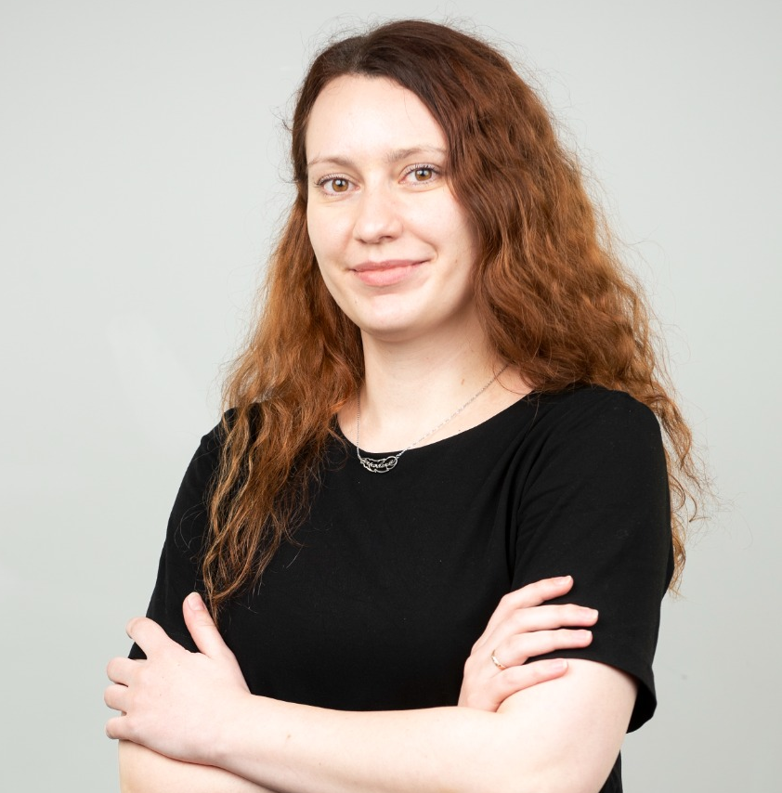
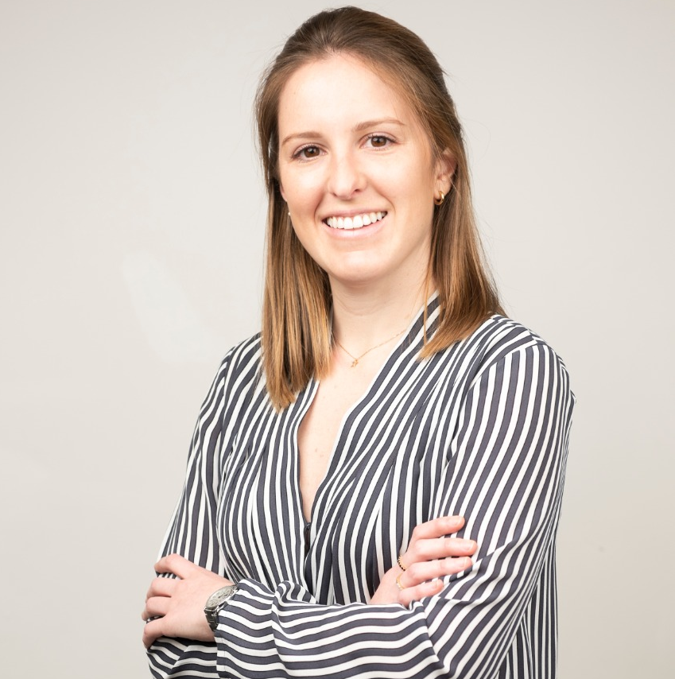
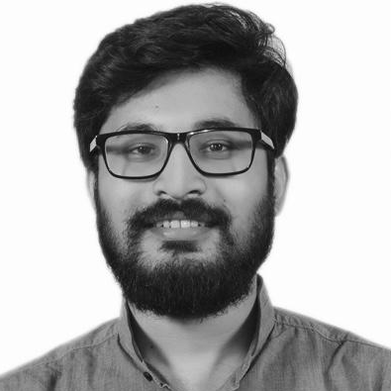
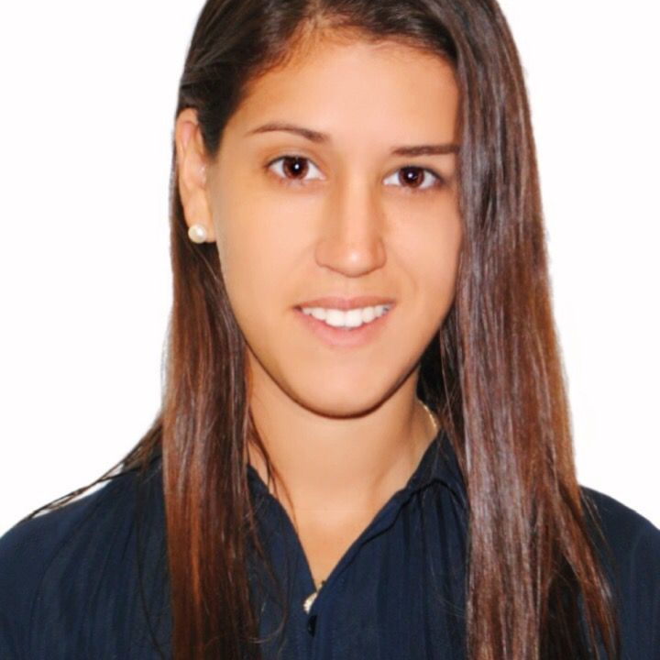
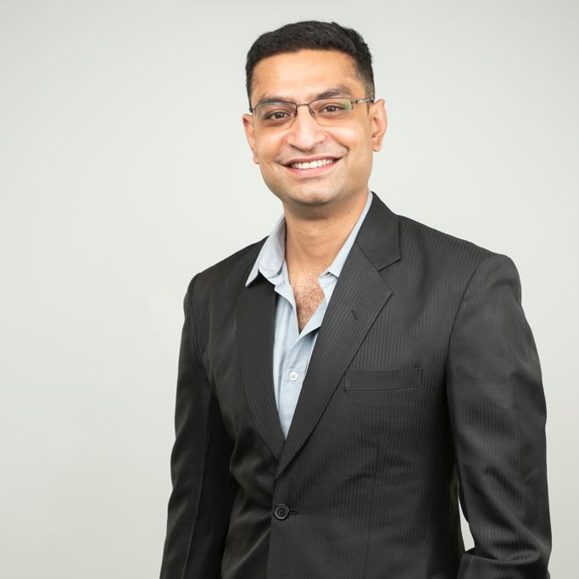
Our Team
Olga
CEO
Paz
Rajat Kumar
CMO
CTO
Flavia
Varun
COO
CRO

Slide 26
Thank you for your perusal.
On behalf of BrightBoard

Slide 27
Questions & Answers

